Slide 1
VCAA Questions
Proteins and Enzymes

Slide 2
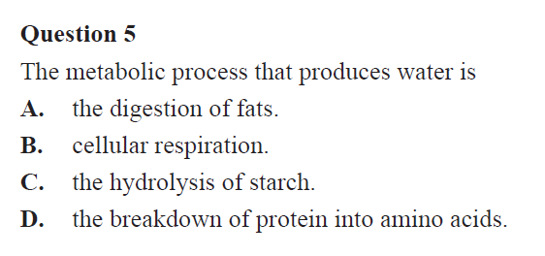

Slide 4
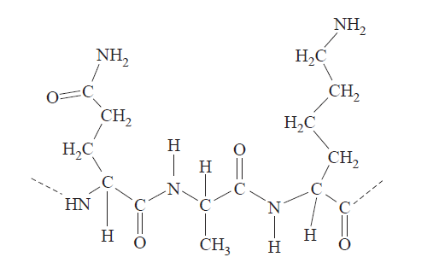

Slide 7
