Slide 1
Chemistry Masterclass
We will be starting at 4.30pm.
In the meantime, please check the following:
Ensure your computer speakers are on and the volume is up
Ensure you have your camera on and your microphone switched off
Click the Q&A button to ask us any questions
Ensure you have any accompanying Masterclass documents in front of you for reference
If you are having any issues, please send us a message through the chat feed

Slide 2
Proteins and Enzymes
With Steve Kuruc

Slide 3
What does VCAA expect RE Proteins/Enzymes?
Proteins: formation of dipeptides and polypeptides as condensation polymers of 2-amino acids; primary (including peptide links), secondary, tertiary and quaternary structure and bonding; distinction between essential and non-essential amino acids as dietary components.
Metabolism of food as a source of energy and raw materials: general principles of metabolism of food involving enzyme-catalysed chemical reactions with reference to the breakdown of large biomolecules in food by hydrolytic reactions to produce smaller molecules, and the subsequent synthesis of large biologically important molecules by condensation reactions of smaller molecules
Enzymes as protein catalysts: active site; modelling of process by which enzymes control specific biochemical reactions (lock-and-key and induced fit models); consequences of variation in enzyme-substrate interaction (lock-and-key mechanism) due to the behaviour of a particular optical isomer; explanation of effects of changes in pH (formation of zwitterions and denaturation), increased temperature (denaturation) and decreased temperature (reduction in activity) on enzyme activity with reference to structure and bonding; action of enzymes in narrow pH ranges; and use of reaction rates to measure enzyme activity
The distinction between denaturation of a protein and hydrolysis of its primary structure…phew!

Slide 4
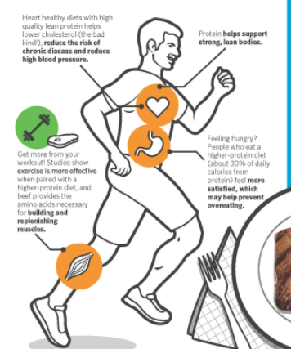
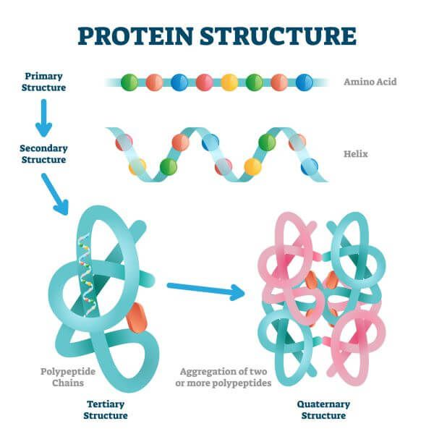
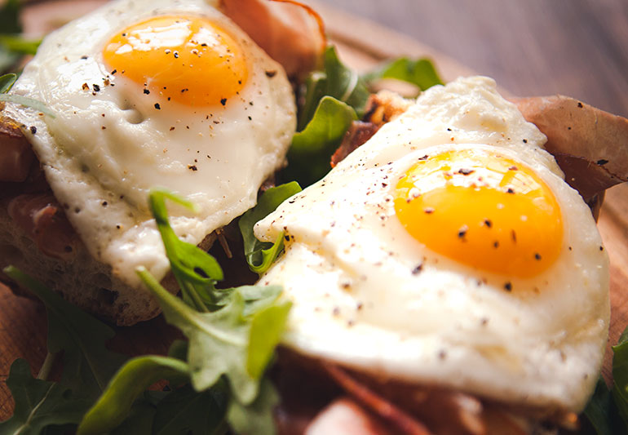
In summary our focus will be…
Body’s needs
Structure and Chemistry
Food and metabolism

Slide 5
Protein content of some foods…

Slide 6
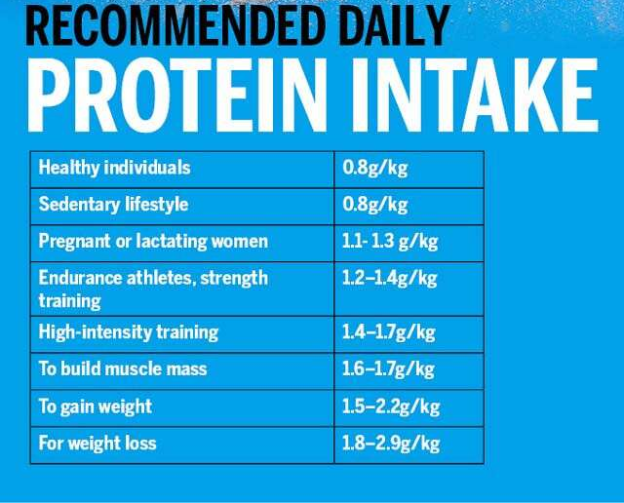
How much protein do you need per day?

Slide 7
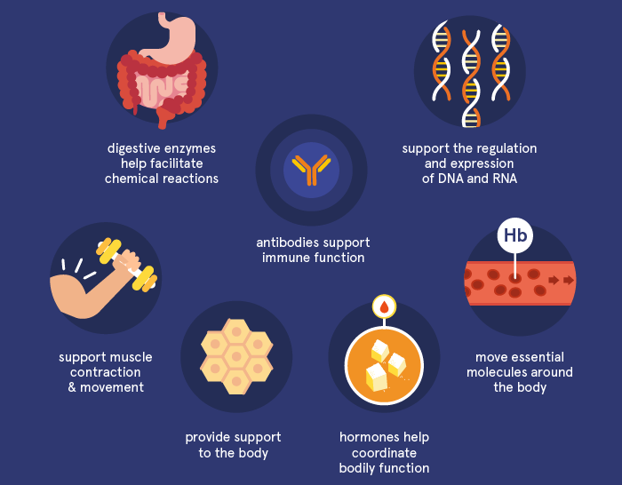
Why are Proteins essential
in the body?

Slide 8
General Content Questions…
Which elements can be present in proteins?
A carbon, hydrogen, oxygen
B carbon, hydrogen, oxygen, nitrogen
C carbon, hydrogen, oxygen, nitrogen, sulphur
D carbon, hydrogen, oxygen, nitrogen, sulphur, phosphorus

Slide 9
Main purpose of proteins in the body?
A energy storage and supply of energy to the body
B enzymes and metabolism to support digestion
C synthesis and repair of body tissues and biomolecules
D oxygen transport and cellular respiration

Slide 10
What are the building blocks of proteins?
A monosaccharides
B glycerol and carboxylic acids
C amino acids
D cellulose

Slide 11
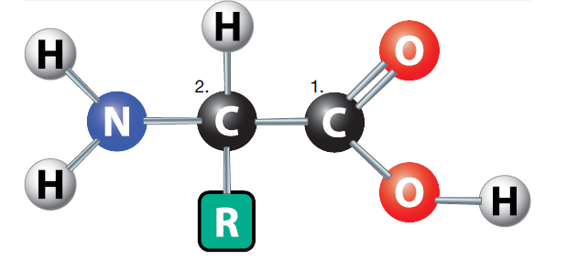
It all starts with Amino Acids

Slide 12
Amino Acids Facts
Most amino acids have four groups bonded to a central carbon atom.
• a carboxyl group −COOH
• an amino group, −NH₂
• a R group (side chain)
• a hydrogen
Amino acids used to make proteins are named ‘2-amino acids’ because the amino group is attached to the 2nd carbon counting from the carboxyl group.
These are also called 𝛼-amino acids ‘alpha’ amino acids.

Slide 13
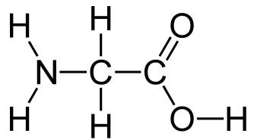
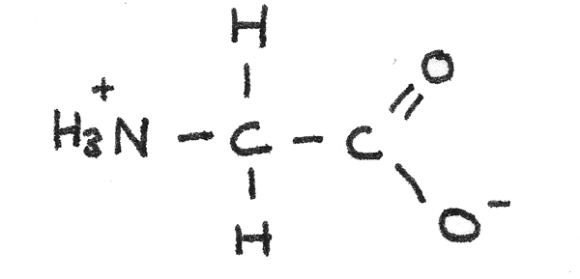
Hello its GLYCINE
Glycine is the simplest amino acid
It is POLAR and therefore water soluble
In solution it self ionises to form a zwitterion

Slide 14
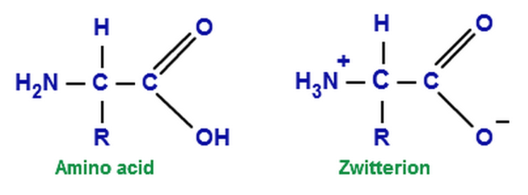
Zwitterions
In neutral solutions, amino acids will self protonate to form a zwitterion. These ions are useful as they act as ‘buffers’. Buffers are chemicals that help resist changes in pH. These chemicals help maintain specific pH environments inside the body that support health and metabolism.
Zwitterions are amphoteric as they can act as both acids and bases ☺

Slide 15
Zwitterions and acids
Can you identify and describe how the zwitterion has acted as a buffer?

Slide 16
Zwitterions and bases
Can you identify and describe how the zwitterion has acted as a buffer?

Slide 17
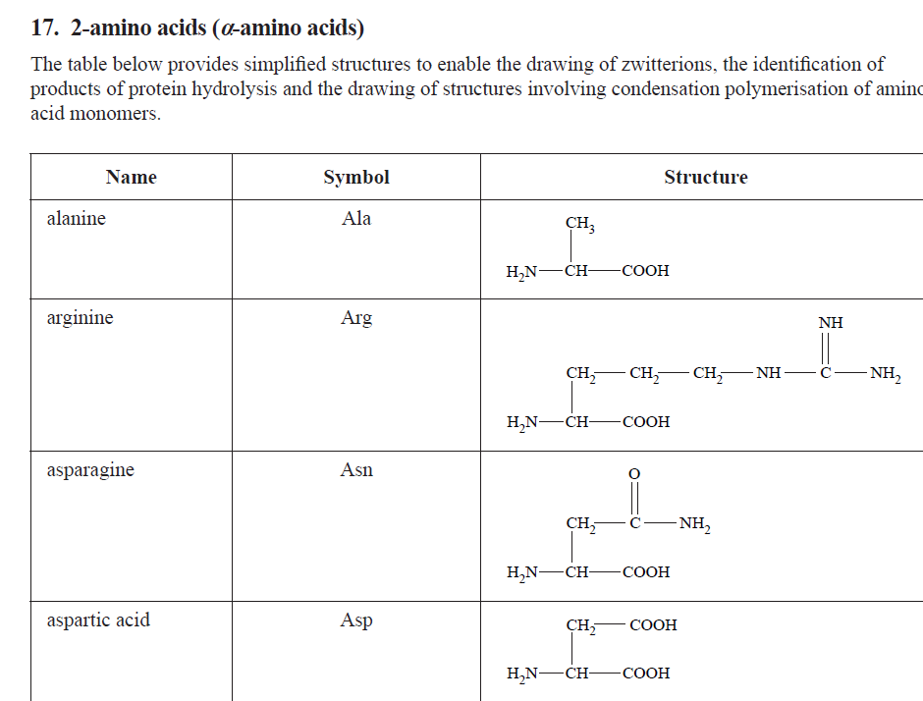
A list of Amino Acids can be found…
VCAA Chemistry Data Booklet

Slide 18
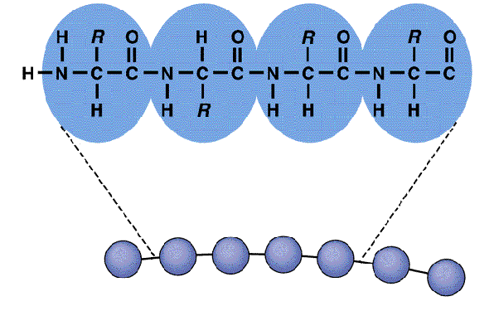
Primary structure of Proteins
The sequence of amino acids present in a protein form its
primary structure.
Strong polar covalent bonding exist between amino acids called peptide links.

Slide 19
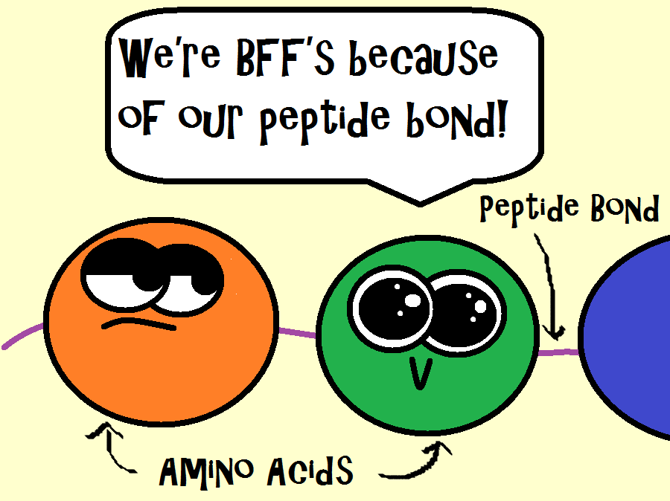
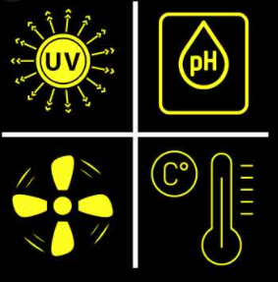
Primary Structure Facts
Changes in pH and temperature do not effect the primary structure of proteins due to the presence of strong covalent bonding.

Slide 20
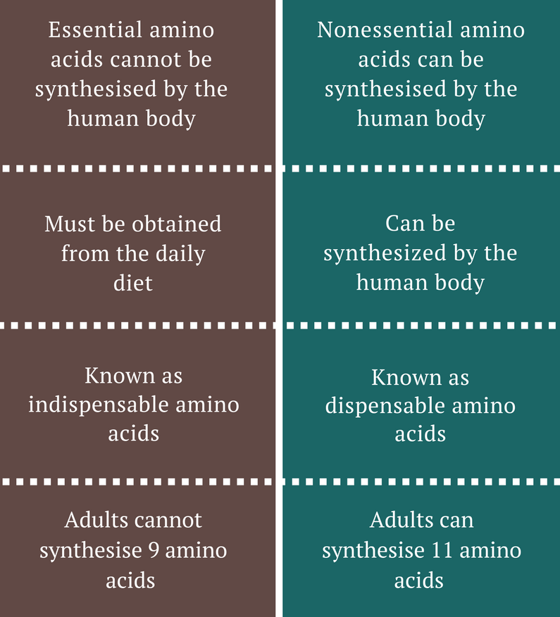
Essential
Vs Non Essential
Amino Acids
Humans can only produce 11 of the 20 amino acids necessary to make proteins. These are classified as non-essential amino acids.
Amino acids that cannot be synthesised by the body must come from our diets and are known as essential amino acids.
Amino acids cannot be stored in the body and must be obtained daily through our diet.

Slide 21
Dipeptides and polypeptides facts…
If 2 amino acids combine, they are said to have formed a ‘dipeptide’.
A polypeptide is a polymer formed when 50 or less amino acids combine.
*A protein contains 50 or more amino acid units.
A peptide linkage occurs when the carboxyl group of one molecule reacts with the amino group of another amino acid molecule. (*condensation reaction).

Slide 22
Dipeptides and polypeptides facts…
The general term ‘amide link’ can be used for
any compound that contains the −CONH− link.
This link is also called a peptide link if it is in a peptide or protein.
When two or more amino acids combine to form a peptide,
what remains of each amino acid in the peptide is called an
amino-acid residue.

Slide 23
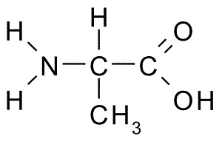
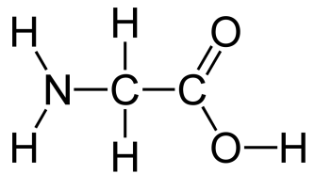
Condensation reactions and dipeptides
Glycine and Alanine can combine via a condensation reaction.
i) Circle the parts of each molecule that will be lost.
ii) Sketch the outcome of this combination when a peptide link is formed.

Slide 24
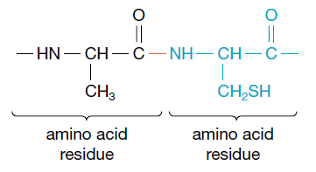
N vs L –terminal ends
Two possible dipeptides can be made depending on the initial alignment of
the amino acids.
The end of the peptide that has a free amino group is described as the N-terminal. This is usually drawn on the left.
The end with a free carboxyl group is called the C-terminal.
This is important because Ala-Gly has a different structure from Gly-Ala ☺

Slide 25
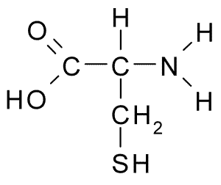
Sketch the outcome of the following combination
Cysteine
Alanine

Slide 26
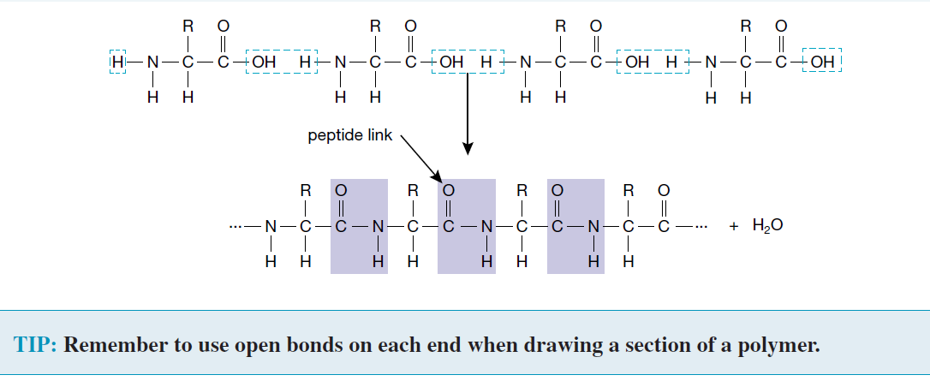

Slide 27
Hydrolysis of a dipeptide
Sketch the outcome of hydrolysis

Slide 28
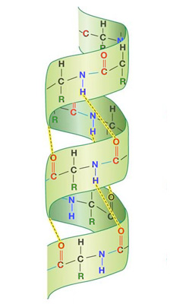
Secondary structures
Result from Hydrogen Bonding
Consists of folds and pleats
*see images provided
Why do these ‘shapes’ form?
Parts of the protein chain attract each other creating these shapes
Changes in temperature and pH effect secondary structures

Slide 30
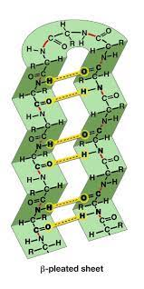
Beta pleated sheets

Slide 31
Tertiary Structures
Refer to the overall three-dimensional structure of a protein. This complex shape is critical to the function of proteins.
Hydrogen, Dipole & Ionic bonding are all present.
Bonding between R-groups, the side chains, of the amino acids results in disulfide bridges.
Non-polar R-groups are hydrophobic and gather on the inside of the protein, leaving hydrophilic R-groups on the surface to interact with the aqueous environment in cells.

Slide 32
Tertiary structures are easily effected by changes in pH and temperature.

Slide 33
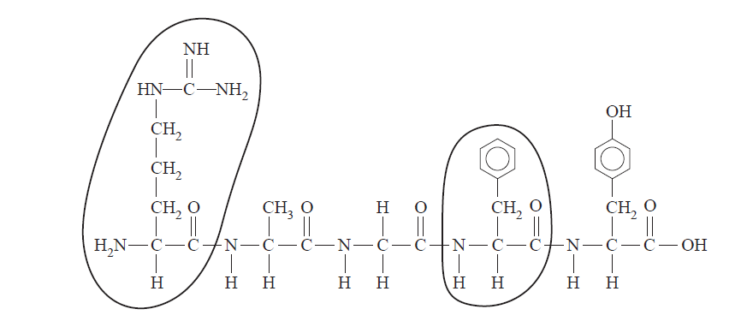
VCAA 2016

Slide 34
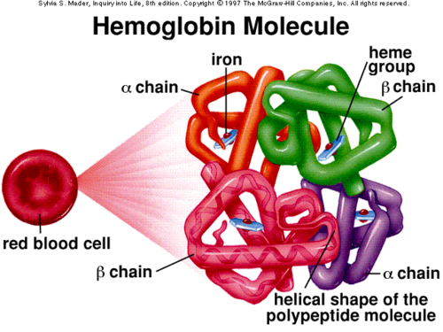
Quaternary Structures
Consist of 2 or more protein molecules linked together in a particular spatial arrangement forming a larger protein complex.
This complex is held together by H- bonding, disulfide links & ionic attractions.
For example, haemoglobin has four chains: two identical 𝛼 chains and two identical 𝛽 sheets.

